Slide 1
DEVELOPMENT OF A FRAMEWORK AND INTERACTIVE DASHBOARD FOR EVALUATION AND MONITORING SMART REGIONS - THE OESTE SMART REGION CASE
BY
Oluwole . J. OLATOKE
Supervisors
Professor Miguel de Castro Neto (NOVA Universidad Lisboa)
Professor Christian Kray (Westfälische Wilhelms- Universität Münster)
Professor Juan Camilo Gómez Esguerra (Universitat Jaume I, Castellón)

Slide 2
Content Layout
1. CONTEXT
2. AIM AND OBJECTIVES
3. DESIGN SCIENCE RESEARCH AND PROCESS
4. DESIGN RESEARCH PROCESS
5. LITERATURE REVIEW
6. SMART REGIONS
7. METHODOLOGY: SELECTION OF DIMENSIONS AND INDICATORS
8. CONCEPTUAL FRAMEWORK
9. DATA AND DATA SOURCES
10. DESCRIPTION OF DATA USED
11. COMPARISON WITH SDGs
12. ETL PROCESS
13. WORKFLOW
14. DASHBOARD DESIGN
15. DASHBOARD DESIGN
16. DASHBOARD DESIGN: SAMPLE
17. DASHBOARD DESIGN: KEY TERMS
18. DEMONSTRATION
19. STAKEHOLDERS FEEDBACK
1

Slide 3
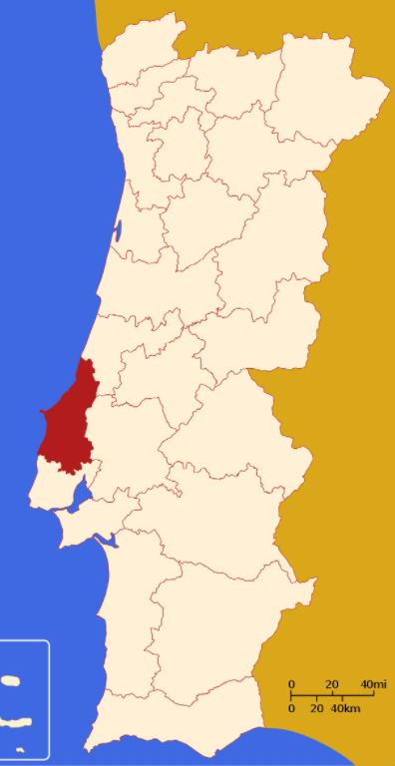
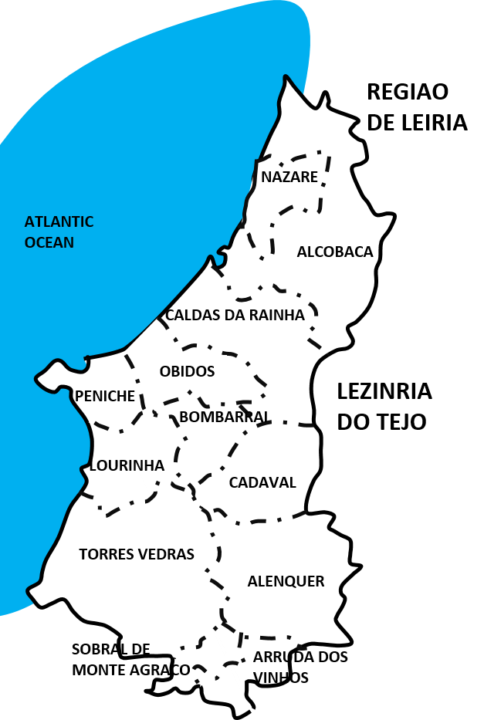
CONTEXT
12 municipalities making up the Oeste Region of Portugal are desirous of creating a smart region.
These municipalities are Alcobaça, Alenquer, Arruda dos Vinhos, Bombarral, Cadaval, Caldas da Rainha, Lourinhã, Nazaré, Óbidos, Peniche, Sobral de Monte Agraço, Torres Vedras
There is therefore a need to develop a framework for the definition of a baseline at the unset of the project as well as for monitoring and evaluation of the project.
2

Slide 4
AIM AND OBJECTIVES
AIM
To develop a framework and interactive dashboard for the monitoring and evaluation of the progress of the Oeste Smart Region project.
OBJECTIVES
Identify and select important dimensions to be monitored in the development of smart regions.
Identify and select key indicators for measuring smart regions.
Develop an interactive dashboard using selected indicators and dimensions to present progress in the smart region
3

Slide 5
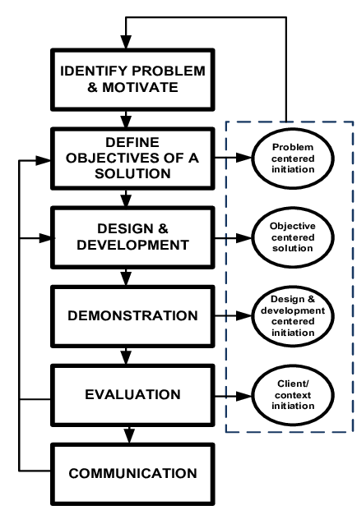
DESIGN SCIENCE RESEARCH AND PROCESS
DSR has been described as the enhancement of technology and scientific knowledge bases through the formation of innovative artifacts that solve problems and improve the environment in which they are instantiated (Vom, Hevner, Maedche 2020)
The goal of design science research is to develop a new reality, create a solution to a problem (Pello, 2018).
It creates a new reality, rather than explaining existing reality or helping to make sense of it (as is in the case of the pure sciences and social sciences)
Peffers et al. (2007) design science research process
4

Slide 6
DESIGN RESEARCH PROCESS
STAGES | ACTIVITY | APPLICATION TO OESTE REGION
1 | Problem identification and motivation | Develop a means of monitoring and evaluating Smart region progress for Oeste.
2 | Define the objectives for a solution | Scientifically select relevant data for dimensions and indicators.
3 | Design and development | Based on selected indicators, create a data model Systematically determine how the different dimensions and indicators will relate (i.e. model) and display on a dashboard both at the municipality and regional level
4 | Demonstration | To be demonstrated: To supervisors To be demonstrated at Oeste
5 | Evaluation | Get feedback from Supervisors Get feedback from Oeste
6 | Communication | Improve dashboard based on feedback received Write final report
5
Adaptation of Peffers et al. (2007) Design Science Research Methodology to Oeste smart region

Slide 7
LITERATURE REVIEW
WHAT IS A SMART REGION
There is no universally agreed definition of what a smart region is
Kodym & Unucka, (2017) viewed it simply as a region that employs modern technology to save time and money for people who live within it
Bauer et al.(2019) understood the concept as a region that solves tasks and challenges by wisely applying new technologies, by organizing processes or by making wise, future-proof decisions.
Shearmur et al. (2017) who also emphasized that smart regions are ‘the result of the dynamics in different economic sectors.
Therefore, a smart region is a territory comprising multiple smaller contiguous territories which together build smart systems to procure improved quality of life for their residents while striving for environmental and economic sustainability.
6

Slide 8
LITERATURE REVIEW
RATIONALE FOR SMART REGIONS
Digital Inclusion
Collaboration and Economy of Scale
Effective Public-Private Collaboration
City Limits are Not Data Limits
Improve Capacity to Provide Service to Small Communities
Establish equilibrium between rural and urban populations and slow rural-urban negative demographic trend.
(Boorsma et al. (2018) , Bauer et al.(2019)
7

Slide 9
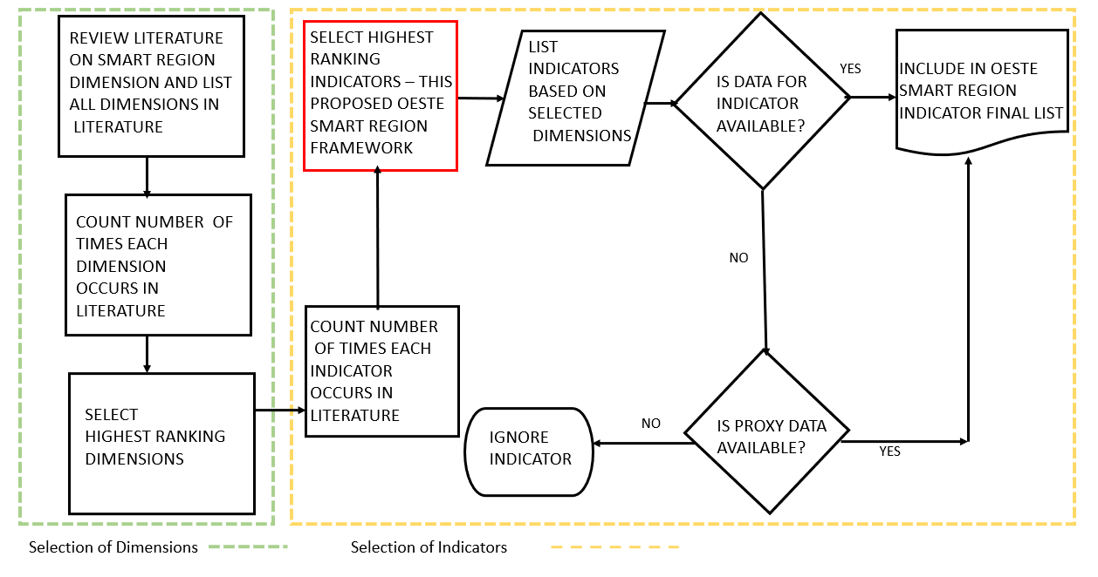
METHODOLOGY: SELECTION OF DIMENSIONS AND INDICATORS
8

Slide 10
DIMENSIONS AND INDICATORS
 | DIMENSION AND INDICATORS | Count
 | Economy/ Prosperity Indicators | 5
1 | Annual number of new start-ups per 100 000 population | 4
2 | Unemployment Rate | 4
3 | No of innovation hubs in the city, whether private or public, per 100.000 inhabitants | 3
4 | R&D Expenditure | 2
5 | Youth Unemployment Rate | 2
6 | Percentage of the labor force employed in the ICT sector | 2
 | Environment Climate and Planet | 5
7 | Water Consumption | 3
8 | GHG Emissions | 3
9 | Green Areas | 3
10 | Solid Waste Treatment | 2
11 | Air Pollution | 2
 | Governance | 4
12 | Percentage of municipal datasets available to the public | 4
13 | Percentage of city services accessible online | 3
14 | Partnership and participation | 2
 | Society, Culture, and People | 4
15 | Student ICT Access | 4
16 | Violent Crime Rate | 3
17 | Cultural Infrastructure | 2
18 | Number of transportation fatalities per 100.000 population | 2
9

Slide 11
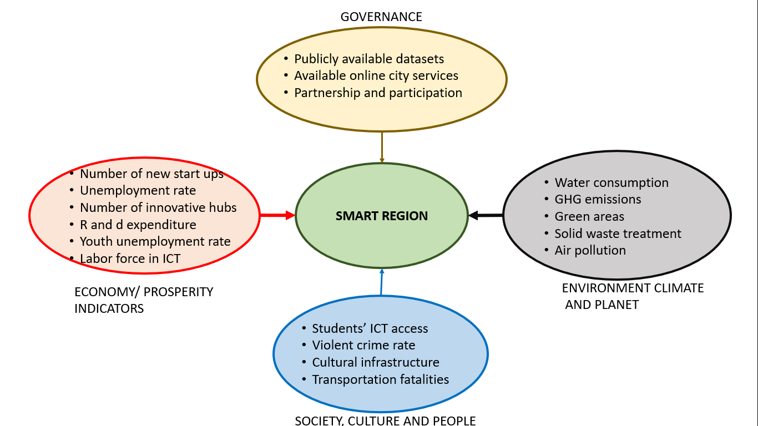
CONCEPTUAL FRAMEWORK
10

Slide 12
DATA AND DATA SOURCES
A Next, created a table which shows:
The indicators
The data used (data found and proxies found)
The data not available
The url to these data sources
B Breakdown of the table showed that:
Number of Indicators = 18
Number of data used = 14
Number of data found = 6
Number of proxies found = 8
Number of data not available = 4
11

Slide 13
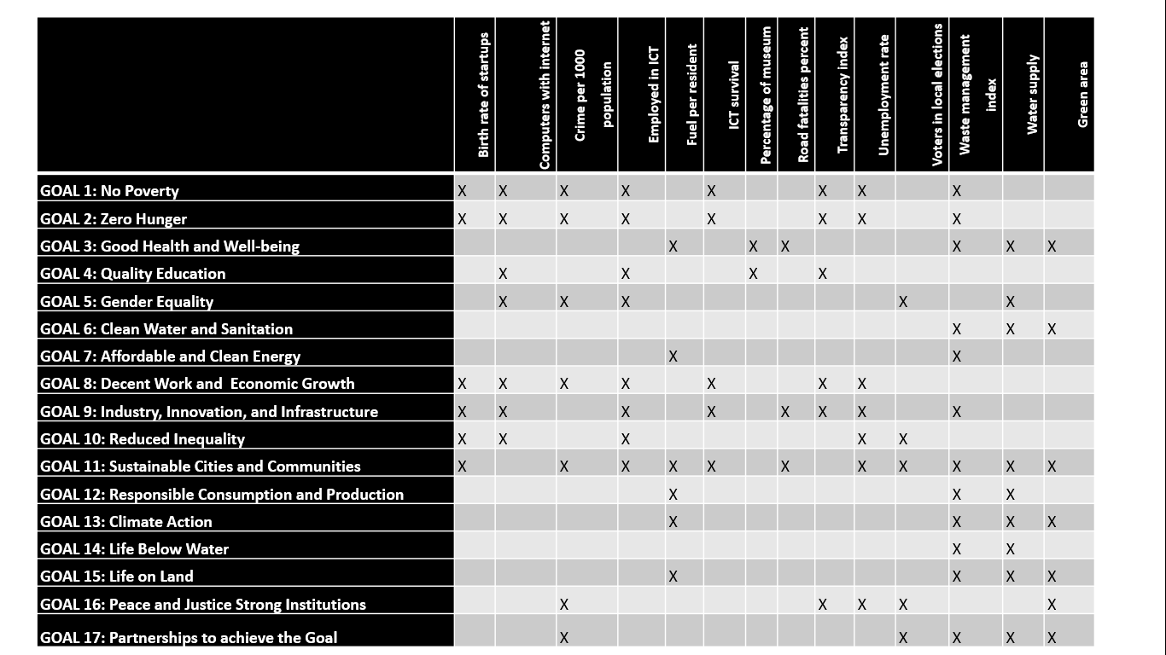
COMPARISON WITH SDGs
Min: Goal 7 = 2
Max: Goal 11= 11
12

Slide 14
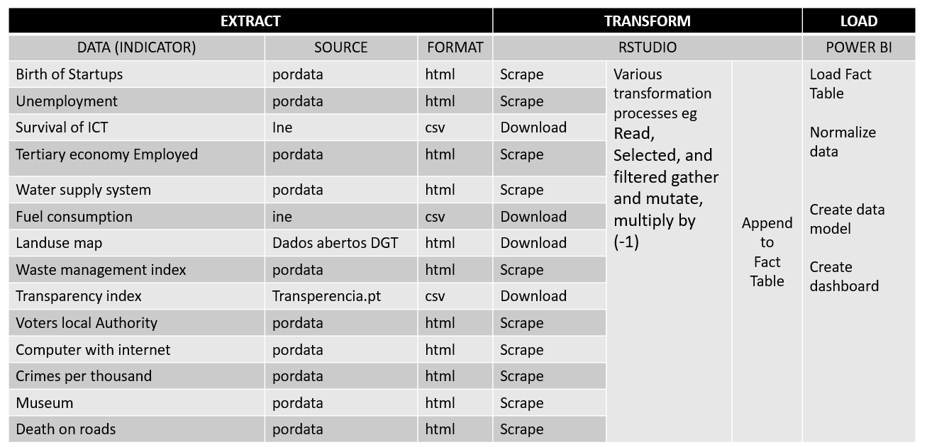
ETL PROCESS
13

Slide 15
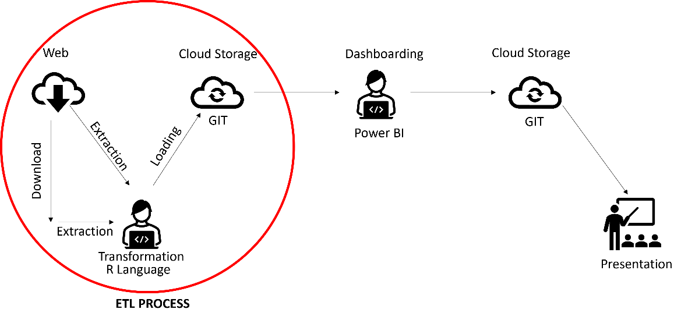
WORKFLOW
14

Slide 16
DASHBOARD DESIGN
Functions
PRINCIPLES
One page
Regional data - default
Municipality data - tooltip
Key data shown as headline
1. Present a number which sums the overall performance of the region
2. Present the score for each dimension.
3. Present the score for each indicator.
4. Present a number that sums the overall performance of each municipality
5. Present performance of each municipality by the different dimensions.
6. Present performance of each municipality by the different indicators.
7. Choropleth map of the scores of the municipalities of the region.
8. The dashboard is also expected to have capabilities to propose targets by indicator, dimension, and municipalities for the region.
15

Slide 17
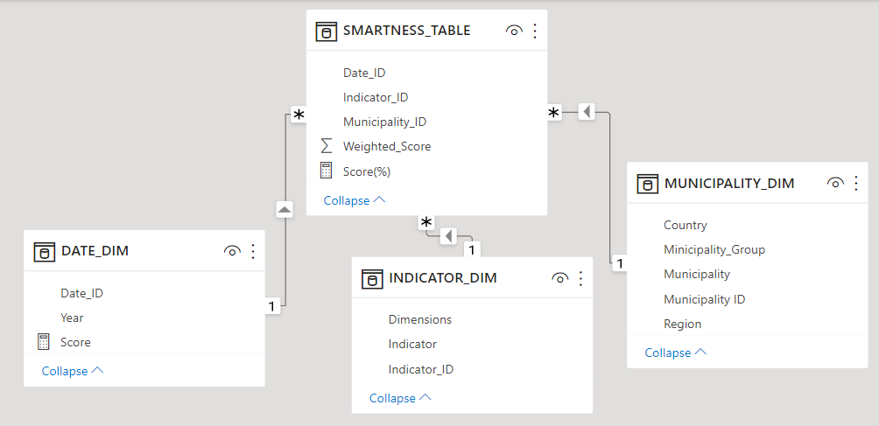
DASHBOARD DESIGN
16

Slide 18
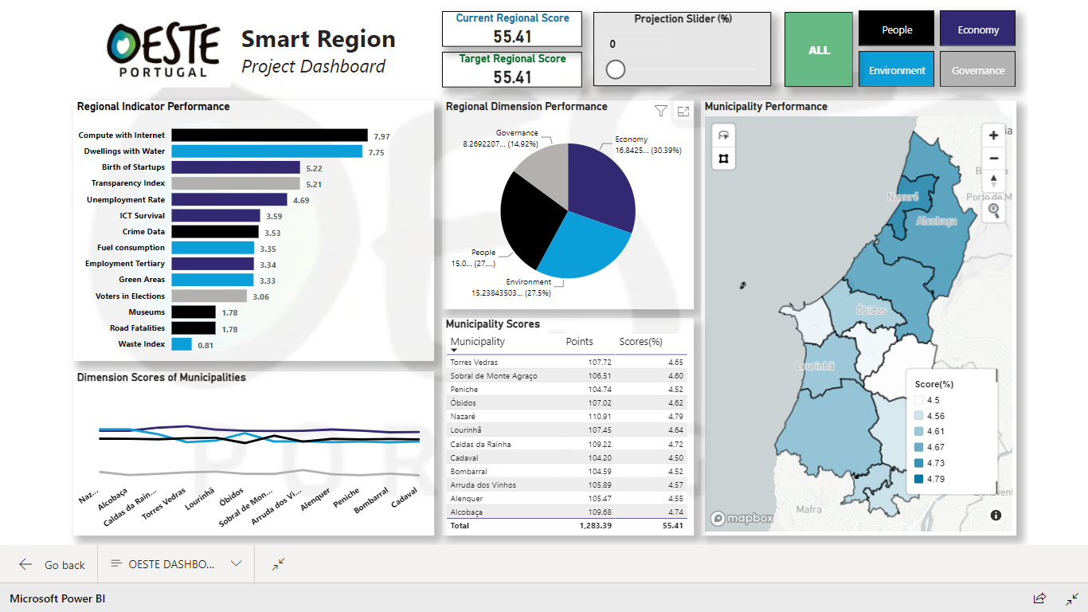
DASHBOARD DESIGN: SAMPLE
Presents Current Regional Score broken down Into Dimensions and Indicators
Presents Target Regional Score
broken down Into Dimensions and Indicators
Tooltip
Tooltip
Tooltip
Tooltip
Presents Regional Scores
of Indicators
Presents
Regional
Scores in Dimension
Tooltip
Presents Municipality Scores by Dimension and indicators (current and target)
17

Slide 19
DASHBOARD DESIGN: KEY TERMS
The values were normalized to range between 0 and 1.
The values of indicators after the normalization process are referred to as points.
Σ (Obtained Points in Region) *100
Σ (Max Obtainable Points)
Current Regional Score =
Σ (Obtained Points in Municipality) *100
Σ (Max Obtainable Points)
Current Municipality Score =
Σ (Target Points in Region)
Σ (Max Obtainable Points) *100
Target Regional Score =
18

Slide 20

DEMONSTRATION
19

Slide 21
FINDINGS
20

Slide 22
LIMITATIONS
Lack of available open-source data
Lack of centralized database for the region
Incompatible data formats
21

Slide 23
FUTURE WORK
The presentation of the dashboard to representatives of the region in order to further get feedback to improve the dashboard
The development of a database which would centralize all the required data and would drive the dashboard
22

Slide 24

CONCLUSION
Identify and select important dimensions to be monitored in the development of smart regions.
Identify and select key indicators for measuring smart regions.
Develop an interactive dashboard using selected indicators and dimensions to present progress in the smart region
23

